Slide 1





AUTOMATED PRECISION
AGRICULTURE
Breakthroughs in food technology
EAST INDIA COMPANY

Slide 2
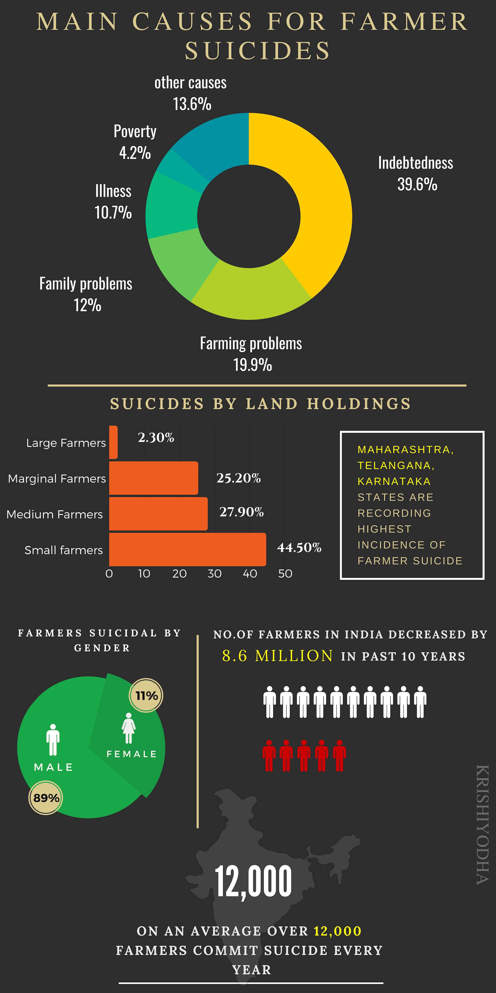

Slide 3
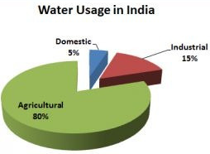
80%
Farming accounts for 80% of the water consumed and most of its wasteful use.

Slide 4










1) SENSE
05
A group of sensors capture
farm data and
upload it to the
ThingSpeak Cloud Platform.
2) ANALYSE
4) ACT
The data is analysed and presented to the farmer on the app for decision making.
Farmers get notifiedand actions can be taken directly from the application.
3) PREDICT
Captured data is used by our prediction models to predict ideal growth conditions, resource , requirement & disease

Slide 5
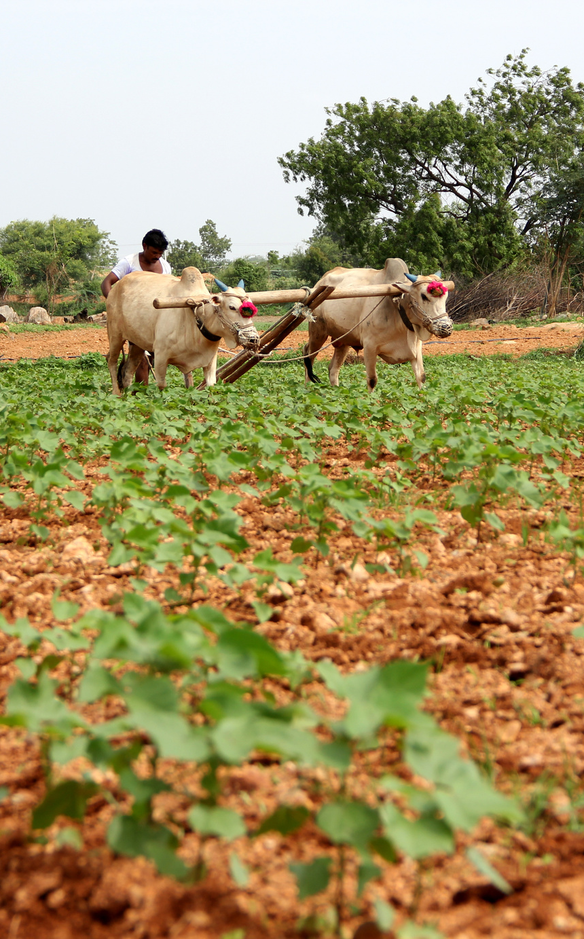
PROBLEM STATEMENT
Excessive water waste by Manual Irrigation
Excessive Manpower
Primitive Usage Methods to Water Crops
Pests and insects are sometimes not detected, hence cause damage to crops

Slide 6
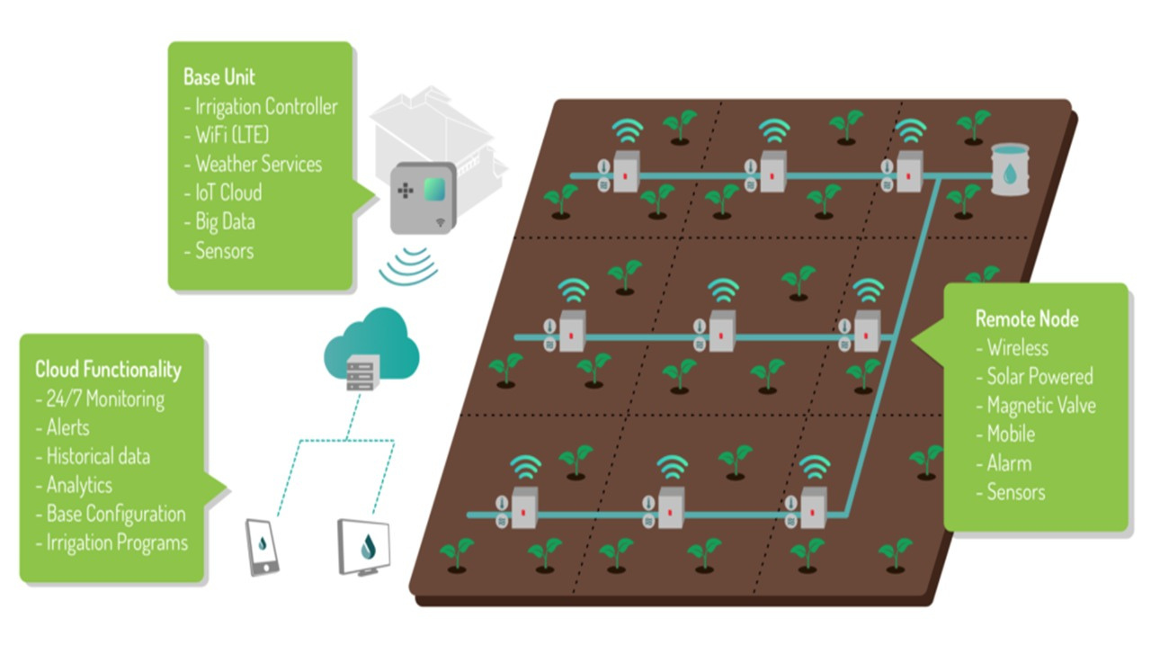

Slide 7





Saves you water and time
Reduces Weed Growth
.
Improves plant growth
Increases Crop Yield thus increasing profit

Slide 8
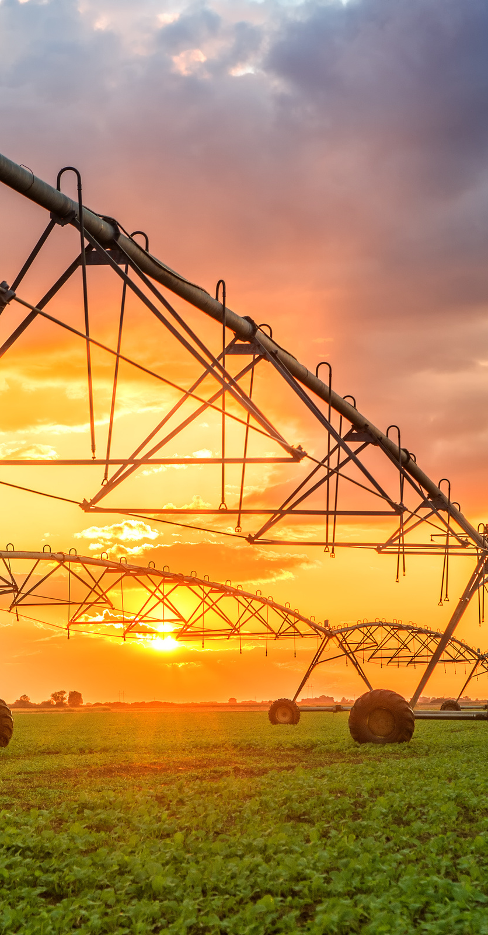
SOLUTION
Saving water with automated precision irrigation at the best possible time.
Saving hundreds of man-hours and eliminating the human factor.
Pests and Insects alert system.
Combining sensors data and cloud intelligence to save even more resources.
Full irrigation control through Mobile Application.

Slide 9
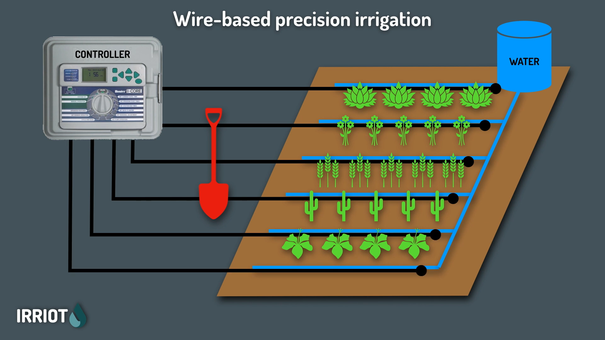

Slide 10
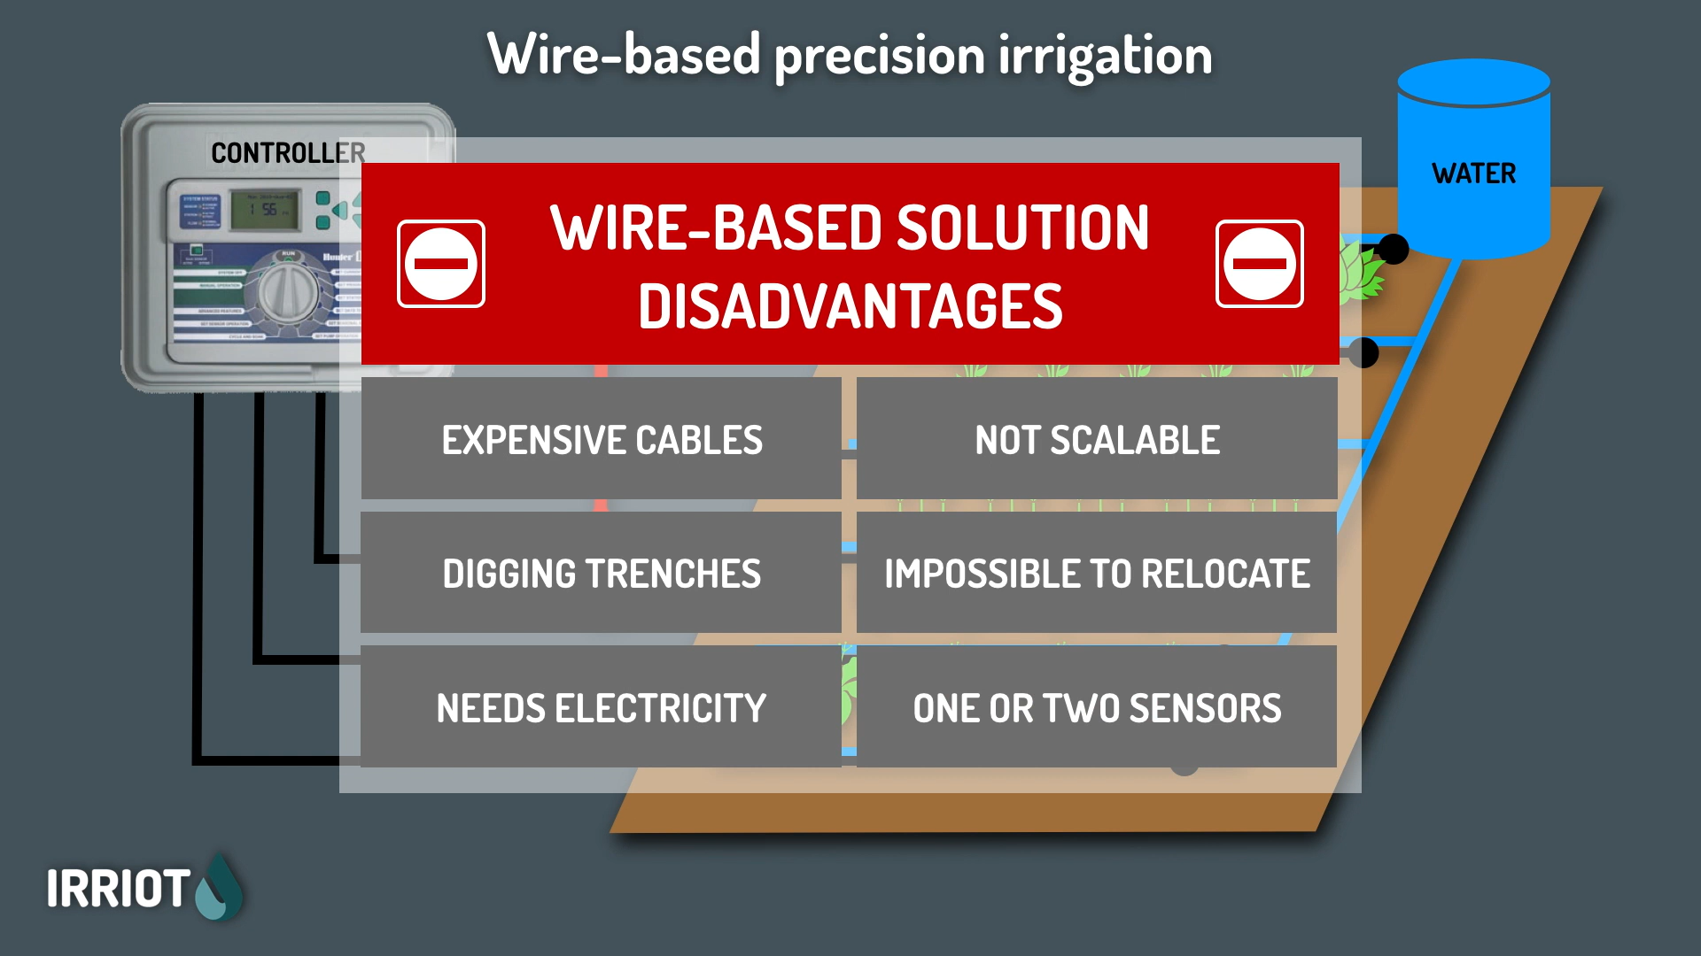
Notes:
This is basically our innovation part, here we are different from most of the companies because we are using Wireless Controllers.

Slide 11
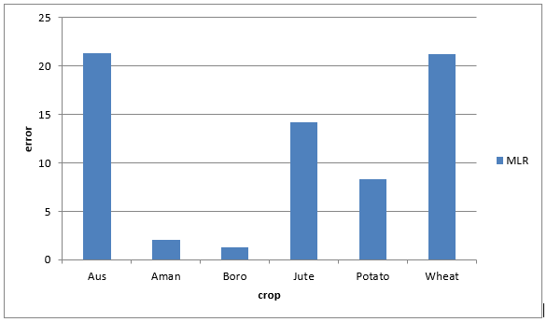
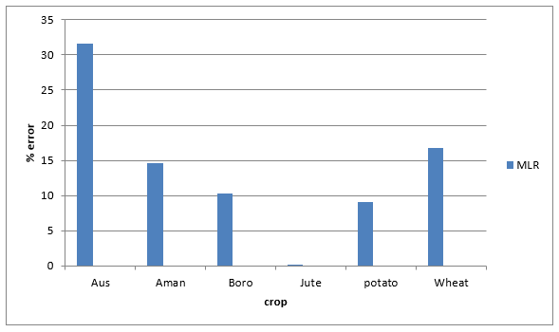
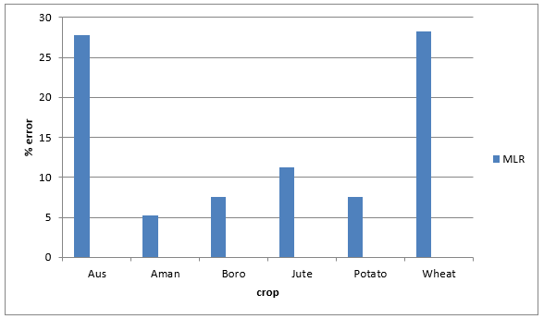
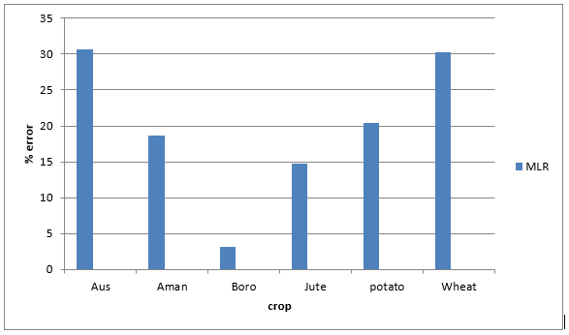
RESULTS
COMILLA REGION
SYLHET REGION
FARIDPUR REGION
DHAKA REGION

Slide 12
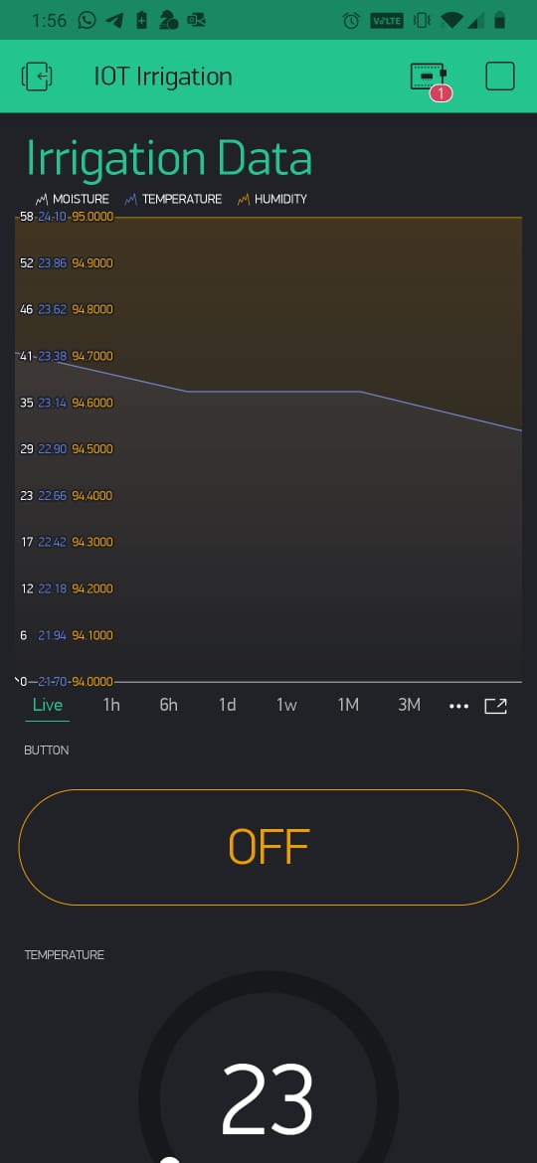
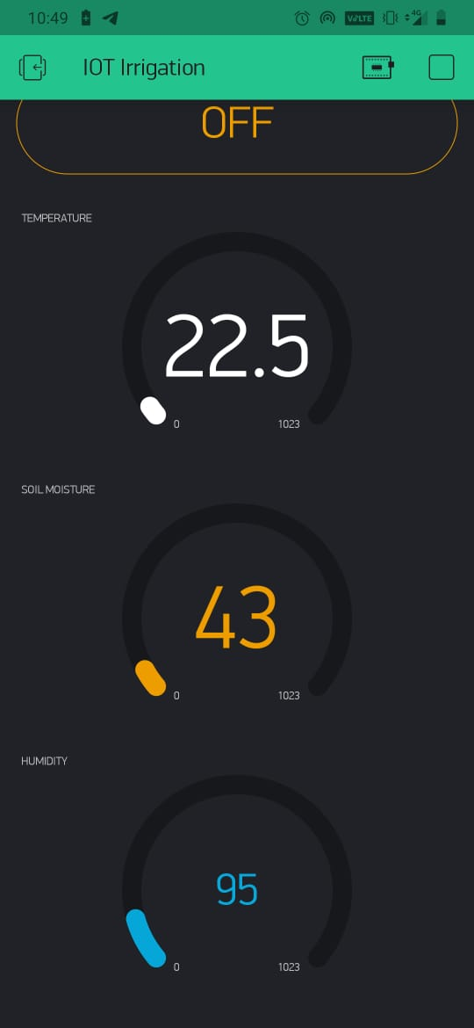
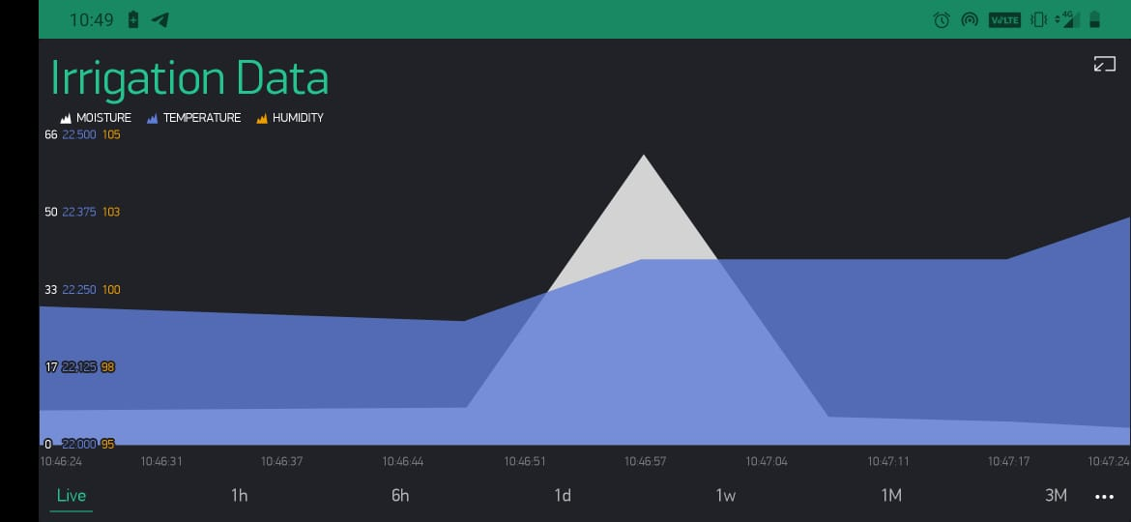
MOBILE APLICATION SNIPPETS

Slide 13
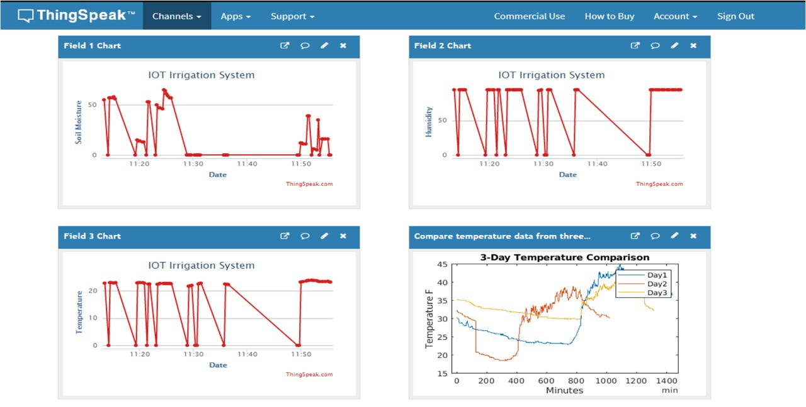
SOIL DATA CAPTURED BY SENSOR SYSTEM

Slide 14

THANK YOU

